Slide 1

NEET Young Londoners
NEAT – Nicely Engaged and Active Technicians
Percy Lam, Nixon Ma, Hugh Bao, Dinesh Dewan

Slide 2
Process
Visualisation + Classification Eval
Categorise Data ⚠️
Interpret Data ⚠️
Clean Data

Slide 3
Clean Data
Dataset: Key Stage 4 destination
7 years worth of data – 2016-23
Across the UK
215K rows even just by focusing in Greater London (60MB)
Divided into 32 boroughs + NaN

Slide 4
Categorise Data
Main independent variables
Establishment: (State schools, special…)
Sex
Ethnicity
Disadvantage
Breakdown (SEN, FSM…)
Main output variables
Destination
Cohort/Pupil count and %

Slide 5
Interpret Data
Problems⁉️
The “most common combination”
Multivariate - fix some variables
Divide and conquer
Focus on NEET - so “not recorded as a sustained destination”
"Establishment" is a clearest divider - Alternative provision, state-funded special, mainstream…
Fix "sex", "ethnicity", "disadvantage status" to see the cohort counts
Destinations - even "overall" doesn't go to 100%
Cohort count = people in the group of independent variables
The stats are recorded at school
For the people who aren't attending schools or the council can't register…

Slide 6
Some codes for Visualisation and Eval
Charts of by borough
NEET percentage and count
Highest risk groups - SEN, ethnicity
Priority score = rate * sqrt(cohort size)
Logistic Regression
feature_cols for X_train: ["borough", "provision_group", "subgroup_type", "subgroup", "cohort_count"]
output y: [‘high_risk’, ‘not_high_risk’]

Slide 7
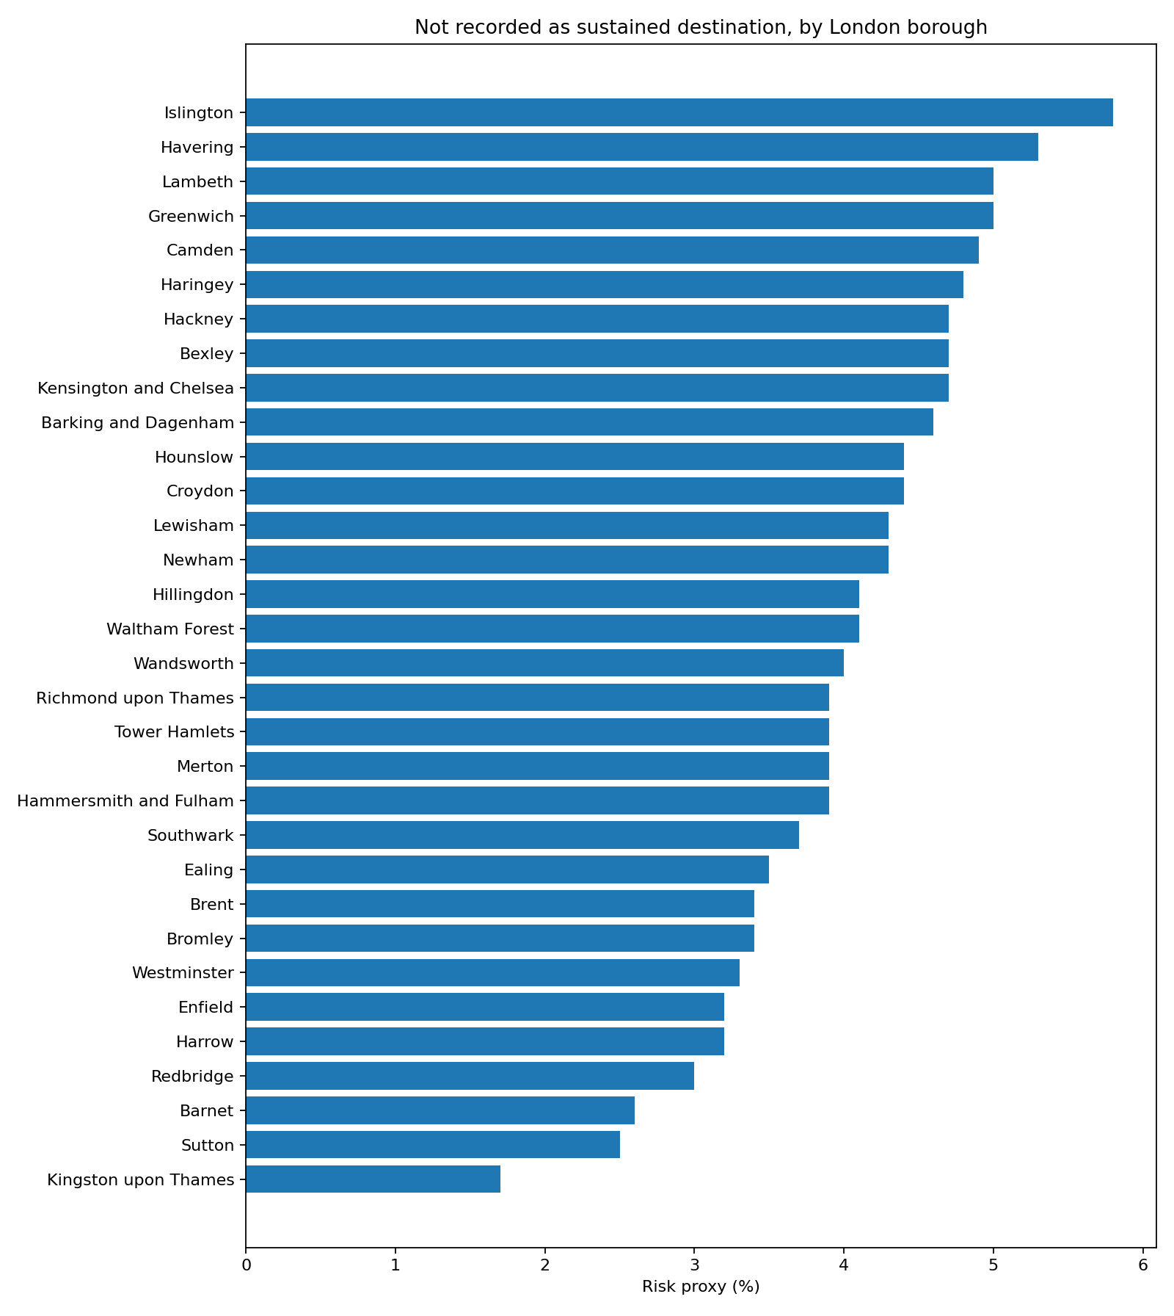
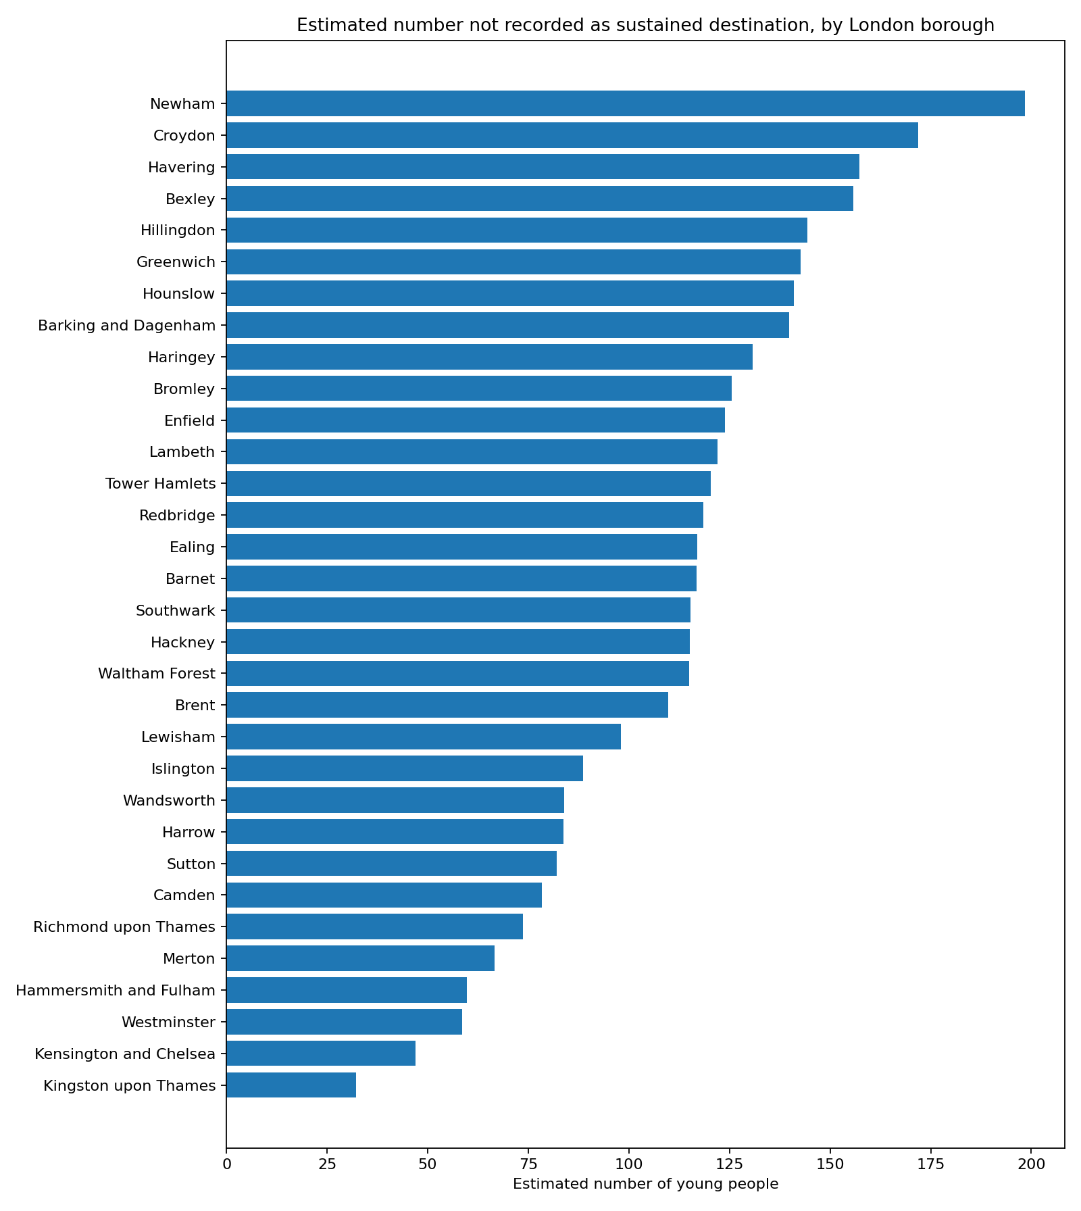

Slide 8
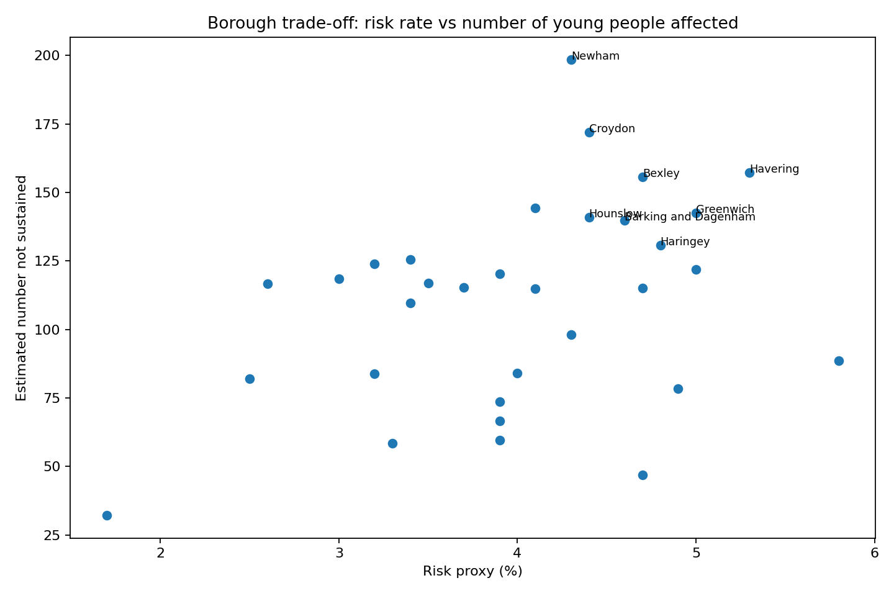
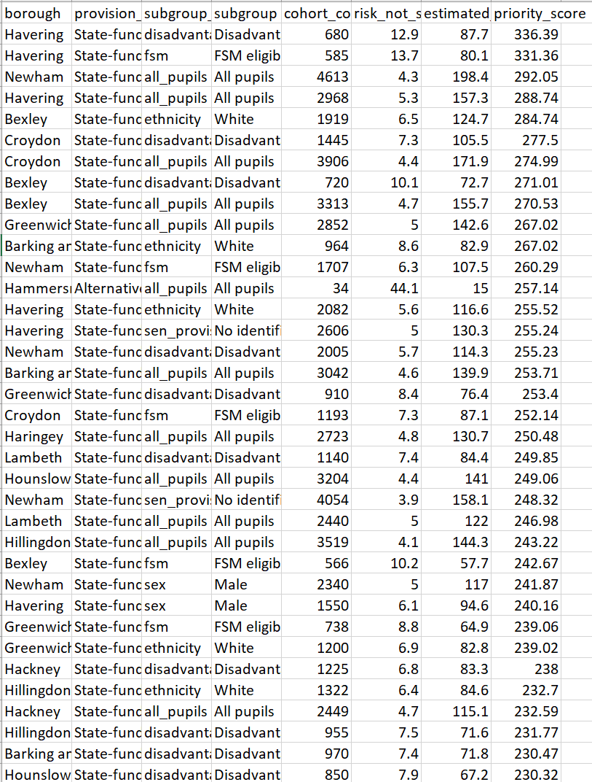

Slide 9
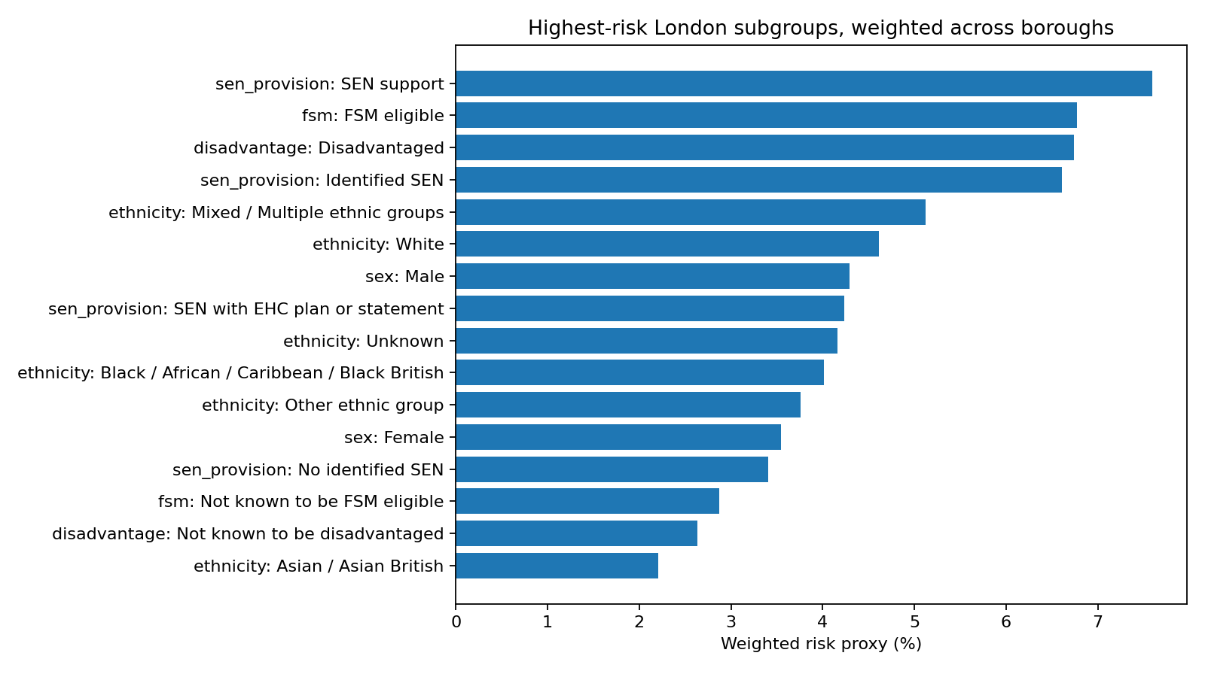
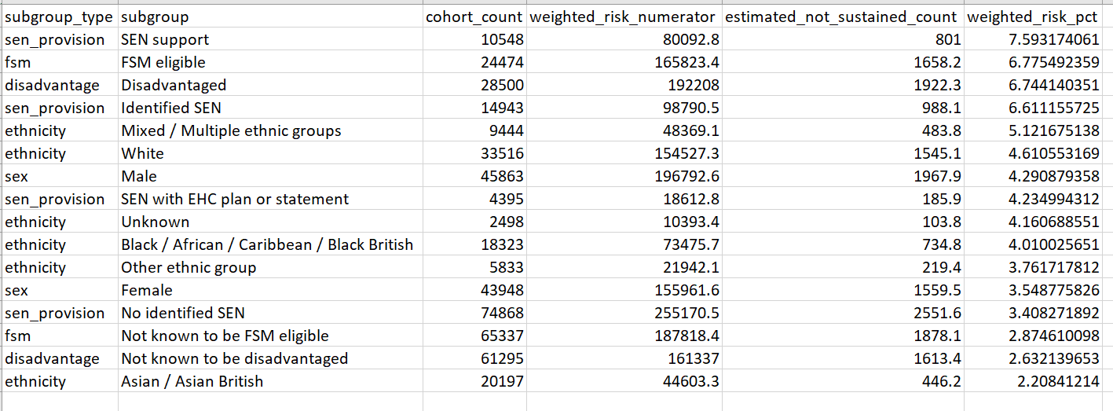

Slide 10
